Slide 1
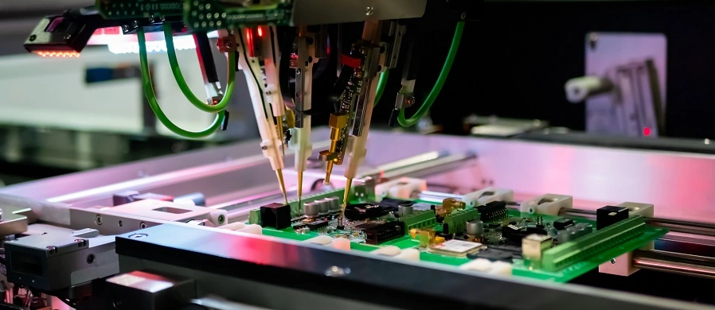


Brochure
Capabilities overview
BSU Incorporated
March025
2025-2026

Slide 2
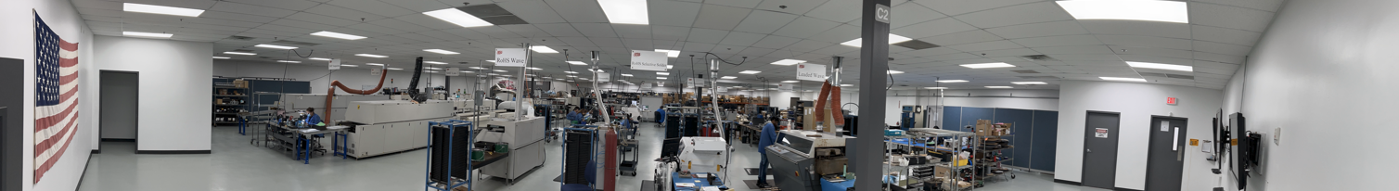



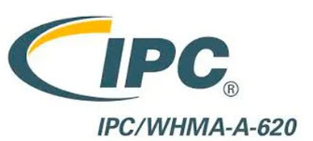


Electronics Contract Manufacturing and Design
Our certifications:
About us
36 years of continuous operations
20k square feet of certified space
Over 1/3rd of our staff are qualified engineers
90% of our customers place repeat orders
3-4x investment in capacity and capabilities in last 18m

Slide 3
Quality parts, timely delivery and clear communication
Our core principals
Quality parts
Dependable, repeatable outcomes driven by our culture of transparency and continuous improvement.
Timely delivery
Flexible lead-times tailored to your needs, including <24 hour turns when parts are in-hand.
Clear communication
Regular, proactive updates and collaboration with our engineering team.

Slide 4

Capabilities and services (1 of 2)
Electronics hardware design
Overall | Analog, digital RF, embedded, FPGA and ASIC hardware design Schematic capture Firmware development and software integration PCB layout including design-for-manufacturability
Printed Circuit Board assembly
Overall | Single and double-sided SMT and through hole No clean and clean/wash ROHS and leaded solder Rework, debug and repair including BGA re-ball, part removal and replacement Turnkey or consigned inputs: cut tape, reels and loose parts
Board sizes | Largest – 20” x 20” (using pick and place) or 40” x 40” (adjustments) Smallest – 0.2” x 0.4” (panelized) and 2” x 2” (non-panelized)
Soldering options | Jet paste, stencil, water soluble and niche pastes Conventional reflow, wave solder and programmable selective solder
Depanelization methods | V-score Mouse bites Mechanical routing

Slide 5
Capabilities and services (2 of 2)
Component procurement
Overall | Dedicated procurement team continuously balancing cost and lead time Sourcing all inputs including SOIC, QFP and TQFN, leadless chip carriers/CSP, through hole/LGA, passives, BGAs and VFBGA and microelectronics Access to hard-to-find and obsolete parts Source housing and other fabricated parts
Testing and add-ons
Inspection and testing | Visual inspection and functional testing In-line SPI and AOI including component height and joint measurement 5Dx X-ray capability and automatic optical inspection Flying probe (technology upgraded in 2024 and 2025)
Cabling and harnessing | Internal and external cable harnesses RF, shielded or unshielded, twisted pair, coax, flex etc.
Box build and system integration | Conformal coatings and press fits Ionic contamination tests Complete electro-mechanical assembly services Complex integration with software Final test and acceptance
High-reliability services | Temperature cycling of boards High pot testing

Slide 6
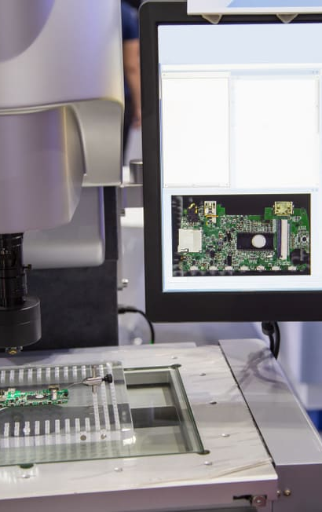
  Email sales@bsuinc.com
Get in touch
  Phone (512) 284-7911
  Learn more at www.bsuinc.com
  Visit us at 1611 Headway Circle, Building 1, Suite 200, TX 78754

Slide 7
Disclaimer: The information contained in this presentation is provided by BSU for informational purposes only and is intended solely for the use of the recipient in evaluating the technical capabilities and services of BSU. This material may not be reproduced, distributed, or disclosed to any third party without the prior written consent of BSU. This presentation is intended to support discussion and overview only. The information provided is not exhaustive and should not be relied upon as a standalone document. Any descriptions of processes, equipment, capabilities, or performance are subject to change without notice. While BSU believes the information presented to be accurate as of the date of presentation, no warranties or representations, express or implied, are made regarding completeness, accuracy, or suitability for a particular application. Actual manufacturing results, yields, and performance may vary based on design, materials, specifications, and operating conditions.

